Slide 1


Smart Bridge using IOT
Mid-Review 1
Major Project
Project ID: Alpha 22
AY 2021-25
GITAM (Deemed-to-be) University
Project Team:
J Yugandhar Reddy - BU21EECE0100418
T Praveen - BU21EECE0100451
K Balaji - BU21EECE0100453
Department of Electrical Electronics and Communication Engineering
Project Mentor:
Dr. Ajith Kumar
Project In-charge:
Dr. Ambar Bajpai
www.gitam.edu

Slide 2
Objective and Goals
Objective
Implement a water level sensor to monitor potential flooding conditions, enhancing the bridge's ability to respond to environmental changes.
Integrate the Blynk app to enable real-time remote monitoring and control of the smart bridge's functionalities via a mobile device.
Expand the existing prototype's capabilities to include more intelligent and automated responses based on sensor data and IoT integration.
Provide a seamless and intuitive user interface for accessing and managing bridge data, ensuring ease of use for monitoring and operational tasks.
Goals
Establish seamless integration with the Blynk app to enable remote monitoring and control of the smart bridge's operations through a user-friendly mobile interface.
Incorporate a water level sensor to monitor and respond to potential flooding scenarios, ensuring real-time data acquisition and improved safety.
Improve automation and system responsiveness by expanding the existing prototype's capabilities based on feedback from multiple review phases.

Slide 3
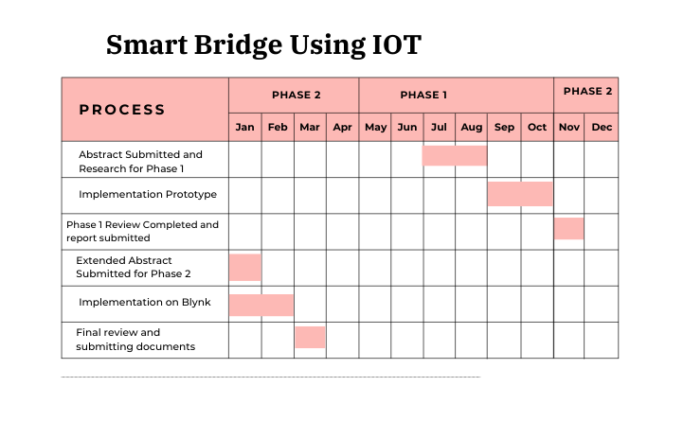
Project Plan
Gant Chart - Milestones and Activities

Slide 4
Literature Survey (Improved post minor project)
Key Publications
The 7th International Conference on Computational Intelligence and Digital Technology (ICCIDT-2K25) to be held during 16th and 17th May 2025.
The 11th IEEE CONECCT, a premier international conference on Electronics, Computing, and Communication Technologies, will be held from July 10-13, 2025, at Sterlings Mac Hotel, Bangalore, India.
Key Resources – Literature Survey
Title | Author and Date | Methodology
Development of an IoT-based Bridge Safety Monitoring System | Jin-Lian Lee , Yaw-Yauan Tyan , Ming-Hui Wen1 , Yun-Wu Wu- 17 May 2017 | The system consists of monitoring devices installed on the bridge, which collect data on water levels, pressure, pipeline conditions, and gas levels. This data is transmitted to a cloud-based server through wireless communication for real-time analysis. The system is powered by photovoltaic units with a sun-tracking mechanism, providing supplementary energy.
IoT Based Bridge Automation with Hybrid Power Supply | Suchismita Dutta, Kingsuk Majumdar, Dola Sinha - 12 November 2022 | The bridge uses solar PV arrays and a MAGLEV windmill as a hybrid power supply, ensuring energy efficiency and automation. The control system is managed via an Android app, with an Arduino UNO, relay module, and Bluetooth, enabling wireless operation. LEDs provide smart illumination controlled by daylight intensity, and the bridge's movements are monitored in real-time using sensors.

Slide 5
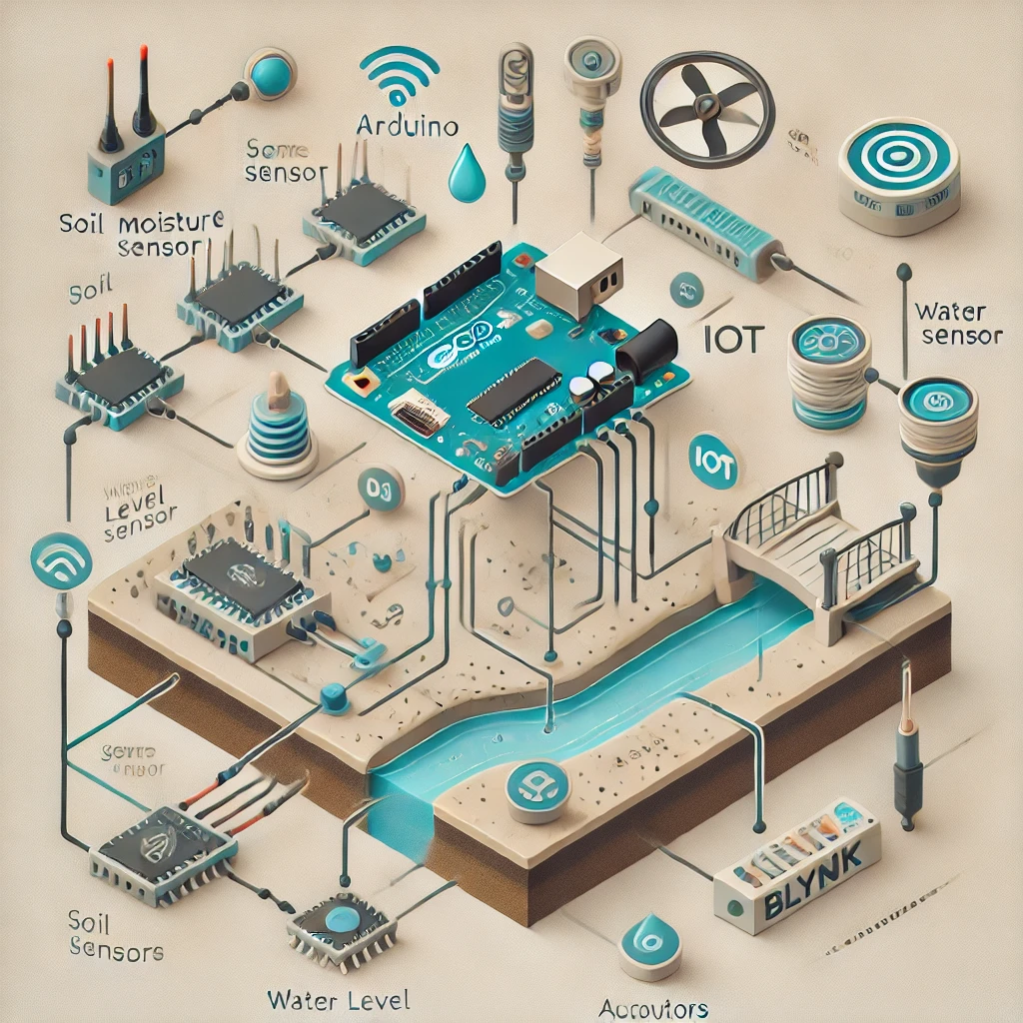
Architecture
Here is the block diagram for your Smart Bridge IoT system.

Slide 6
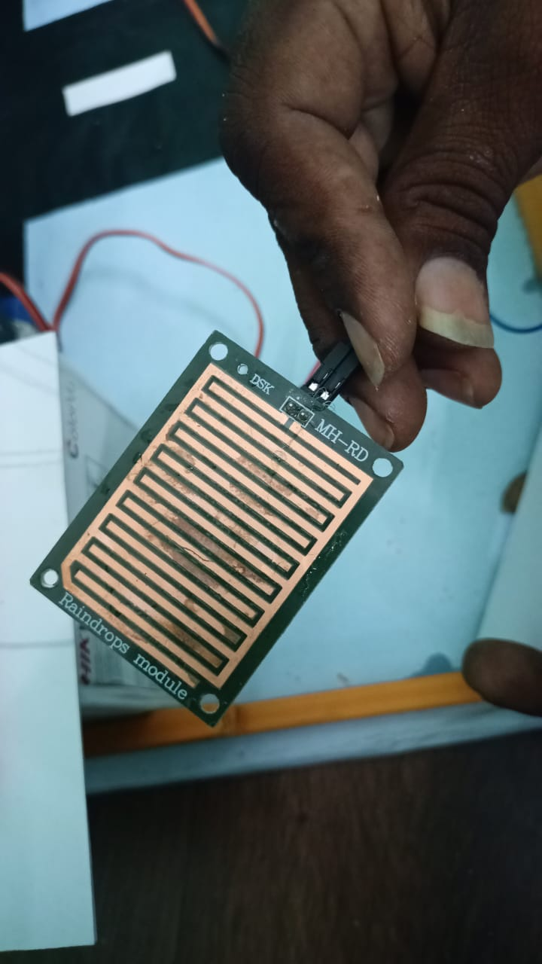
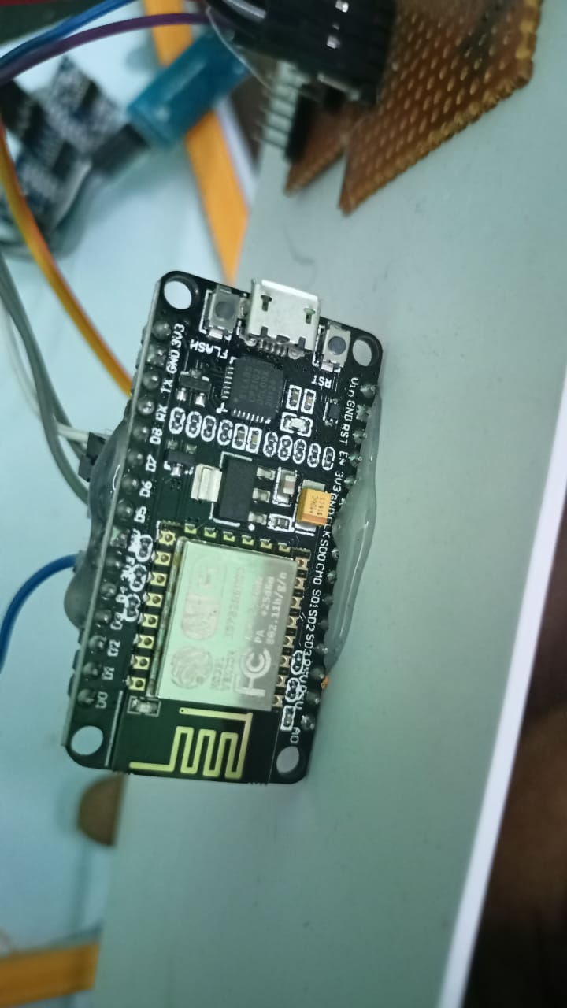
Implementation
Input Sensors
Soil Moisture Sensor:
Used to monitor soil conditions around the bridge, primarily to assess environmental safety.
Sends analog data to the Arduino for processing.
Water Level Sensor:
Measures water levels beneath the bridge to detect potential flooding.
The sensor provides real-time data to ensure the bridge remains operational during heavy rains or rising water levels.
2. Processing Unit
Arduino Microcontroller:
Acts as the central hub for data processing.
Receives data from the soil moisture and water level sensors.
Uses pre-programmed logic to decide how the system should respond (e.g., sending alerts or activating the bridge mechanism).

Slide 7
Implementation
3. Actuators
Servo Motors:
Controlled by the Arduino to simulate bridge movements or adjust certain parts of the bridge dynamically.
For example, the bridge can be raised or adjusted if flooding conditions are detected.
4. IoT Communication Module
Wi-Fi or IoT Module:
Connects the Arduino to the internet for real-time communication with the Blynk app.
Sends sensor data and bridge status to the app while receiving commands from the user.
Enables remote monitoring and control.
5. Blynk IoT App
Provides a graphical interface on a mobile device for:
Viewing live sensor data (e.g., soil moisture levels, water levels).
Sending control commands to the Arduino (e.g., opening or closing the bridge).
Generating alerts or notifications if critical thresholds are exceeded.

Slide 8
Data Flow from Blynk App to Arduino
User Input on Blynk App:
The user sends a command through the Blynk app, such as opening the bridge, closing the bridge, or requesting specific sensor data.
The command is sent using a widget like a button or slider.
Command Transmission to Blynk Cloud:
The Blynk app transmits the user input to the Blynk Cloud server.
Command Reception by IoT Module:
The IoT module polls the Blynk Cloud server for new commands.
When a command is received, it is forwarded to the Arduino through UART.
Arduino Executes Command:
The Arduino interprets the command and executes the corresponding action.
For example:
If the command is to open the bridge, the Arduino signals the servo motors to adjust the bridge.
If the command is to request real-time data, the Arduino sends updated sensor readings back to the Blynk Cloud.

Slide 9
Conclusion & Future Work
Summary and Conclusion
We successfully demonstrated the initial progress made in Phase 2 of the project, "Smart Bridge Using IoT." The extended abstract has been submitted, and the foundational steps for integrating IoT functionality with the Blynk app and water level monitoring have been initiated.
We presented the updated block diagram, initial hardware connections, and the implementation plan for the upcoming milestones.
Key challenges, such as sensor calibration and connectivity issues, were discussed, along with proposed solutions to ensure smooth progress. Feedback from this review will be incorporated into refining the prototype
Future Work
Fine-tune the water level sensor for accurate flood detection, and conduct extensive testing to ensure reliable data acquisition and real-time automated responses, such as raising the bridge during high water levels.
Test the complete system under simulated environmental conditions to validate performance, followed by final integration of all components (hardware and software) and thorough documentation.
Establish seamless connectivity between the Arduino and the Blynk app, while designing and testing a user-friendly dashboard for remote monitoring and control of the smart bridge's functions.

Slide 10
THANK YOU
Have a Great Day !

